Slide 1

The Dyslexia Handbook
Revised 2014
Notes:
This presentation provides an overview of The Dyslexia Handbook-Revised 2014: Procedures Concerning Dyslexia and Related Disorders.
NOTE: Advise the participants to bring a copy of the revised handbook to the presentation. The handbook will serve as the handout for the presentation. The participants may download and print a copy from the Region 10 ESC Dyslexia webpage: http://www.region10.org/dyslexia/index/

Slide 2

What We have learned
Reading is the fundamental skill upon which all formal education depends. Research now shows that a child who doesn’t learn the reading basics early is unlikely to learn them at all. Any child who doesn’t learn to read early and well will not easily master other skills and knowledge and is unlikely to ever flourish in school or life.
L.C. Moats, 1999
Notes:
This quote introduces the Foreword on page 3 of the handbook.
This slide highlights Texas’s long history of supporting the fundamental skill of reading. Direct the participants to the second paragraph on page 3 as you restate the focus on early identification and intervention for children experiencing reading difficulties.
Direct the participants to the last sentence of longest paragraph and restate the sentence: “This handbook replaces all previous handbooks and guidelines.”

Slide 3
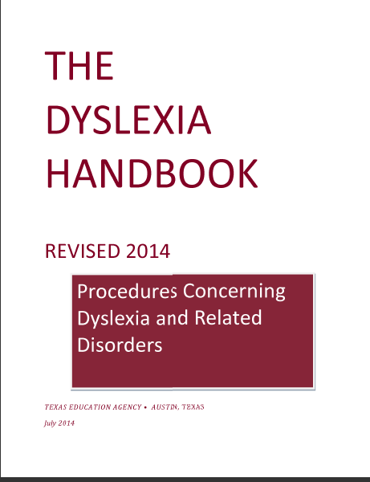
Scavenger Hunt
Notes:
While some participants will notice several differences from the 2010 handbook, this presentation is not a side-by-side comparison, as the format has been dramatically changed and does not lend itself to a side-by-side comparison. This activity will provide the participants an opportunity to become familiar with how the handbook is set up.
Group at least five participants per table for this activity. Provide one envelope per table. Allow 15–20 minutes for this activity.
Note: You will need to prepare this activity in advance of the training. You will need one envelope and five index cards per envelope for each group of participants. Each index card will have directions for the participants to locate parts of the handbook. Each index card contains the following information:
Card 1 – “Locate the “Copyright Notice” and be prepared to discuss with your group.”
Card 2 – “Locate the “Table of Contents” and be prepared to discuss with your group.”
Card 3 – “Locate the “Dyslexia Hotline” and be prepared to share the location with your group.”
Card 4 – “Locate the “Preface” and be prepared to discuss the legislation from the 82nd and 83rd sessions with your group.”
Card 5 – “Locate and identify the 10 tabs/sections of the handbook and corresponding categories and be prepared to discuss with your
group.”

Slide 4
Handbook’s purpose
SBOE-approved procedures
School district guidelines for written procedures
State’s dyslexia statutes and the relationship to federal laws
Resource for educator preparation programs
Notes:
This information is discussed on page 6 of the handbook.

Slide 5
82nd and 83rd Texas Legislative Sessions
TEC §21.044(c)(2)
TEC §21.054(b) and TAC §232.11
TEC §28.021(b)
TEC §38.003(b-1) and TEC §51.9701
TEC §38.0031
TEC §42.006(a-1)
TAC §230.23
Notes:
This slide highlights the legislative action from the 82nd and 83rd sessions of the Texas Legislature. The handbook provides a brief description of each law and rule on page 6.
Participants will have an opportunity to review these state laws and SBOE rules, as well as federal laws, throughout the presentation. These procedures for compliance are also located in Appendix B and Appendix H of the handbook.

Slide 6
Definitions and Characteristics of Dyslexia
Chapter I
Notes:
This is the title slide for Chapter I.

Slide 7

Definitions and Characteristics of Dyslexia
Texas Education Code (TEC) §38.003 defines dyslexia and related disorders.
The International Dyslexia Association (2002) defines dyslexia and secondary consequences.
Notes:
Direct the participants to locate the definition of dyslexia and related disorders as written by the Texas Education Code (TEC) §38.003 on page 8 of the handbook. There are terms defined in Appendix E (Associated Terms) that provide additional information on disabilities that are associated with dyslexia. Direct the participants to Appendix E for these definitions.
Direct the participants to locate on page 8 the definition of dyslexia as adopted by the International Dyslexia Association Board of Directors.

Slide 8
Definitions and Characteristics of Dyslexia
Individuals will demonstrate differences in degree of impairment for the following primary characteristics of dyslexia:
  Difficulty reading words in isolation
  Difficulty accurately decoding unfamiliar words
  Difficulty with oral reading
  Difficulty spelling
Notes:
While these are the primary characteristics of dyslexia, not every student will demonstrate the same degree of impairment. This information is found on page 8 of the handbook.

Slide 9
Definitions and Characteristics of Dyslexia
The primary characteristics of dyslexia are most often associated with the following:
  Segmenting, blending, and manipulating sounds
  Learning the names of letters and their associated sounds
  Holding information about sounds and words in memory
  Rapidly recalling the names of familiar objects, colors, or letters
Notes:
Direct the participants to the information found on pages 8–9 of the handbook. Take note of the bolded words on the slide.

Slide 10
Sources of Information
A list of source documents follows each section within each chapter.
Notes:
Research sources are provided at the end of each section, and all resources are included in the bibliography (Appendix F).

Slide 11
Think about it
Connecting Research and Practice
New research in understanding dyslexia as a neurodevelopmental disorder is ongoing. Future research will assist in learning more about the phonological awareness deficit and how this deficit interacts with other factors related to dyslexia.
Notes:
This information comes directly from page 9 of the handbook. The main idea at this point is to convey the message that research continues to broaden our understanding of dyslexia and response to treatment.

Slide 12
Definitions and Characteristics of Dyslexia
Common Risks Factors Associated with Dyslexia
  Preschool
  Kindergarten and First Grade
  Second Grade and Third Grade
  Fourth Grade through Sixth Grade
  Middle School and High School
  Postsecondary
Notes:
You will want to restate the following from page 9 of the handbook: “If the following behaviors are unexpected for an individual’s age, educational level, or cognitive abilities, they may be risk factors associated with dyslexia. A student with dyslexia usually exhibits several of these behaviors that persist over time and interfere with his/her learning.” It is important to note that a family history of dyslexia may be present and that recent studies reveal that reading disabilities are strongly determined by genetic predispositions.
Direct the participants to pages 9–11 to review common risk factors associated with dyslexia at the various grade levels.

Slide 13
Think about it
Associated Academic Difficulties and Other Conditions
Besides academic struggles, some students with dyslexia may exhibit other complex conditions and/or behaviors.
Notes:
This information comes directly from page 11 of the handbook. Direct the participants to locate the section titled “Associated Academic Difficulties and Other Conditions,” on page 11 of the handbook.
Allow participants to read Associated Academic Difficulties and Other Conditions and share their thoughts with their group. Have participants read and discuss the paragraphs on page 11 and use as much time as needed for clarification (approximately five minutes).

Slide 14
Assessment and Identification
Chapter II
Notes:
This is the title slide for Chapter II.

Slide 15

Procedures for the Assessment and Identification of Students with Dyslexia
Notes:
The participants will “jigsaw” pages 13–15 of the handbook. Divide participants into groups of six for this activity. Once there are 6 participants per group, two participants from each group will work on one of the three pages and report out to their group. This activity may require 20–30 minutes to allow participants time to read and share with their group.
Have each group report out to the whole group key points from each of the three pages. Key points should include early identification, response to intervention and the delay of an evaluation, district procedures for parent’s request to evaluate, and the laws outlined in Figure 2.1.
These pages will prepare the participants for the next section titled Procedures for Assessment.

Slide 16

Procedures for Assessment
Section 504
IDEA
TEC §38.003(a)
19 TAC §74.28
TEC §28.006
Written Procedures
Notes:
Direct the participants to page 16 of the handbook. Read and discuss each of the bullets listed on the slide and how they relate to the assessment process for the identification of dyslexia.
Have participants locate in their handbooks and highlight the information from each bullet as it is discussed.

Slide 17

Procedures for Assessment
The first step in the assessment process, data gathering, should be an integral part of the district’s or charter school’s process for any student exhibiting learning difficulties.
Notes:
This information is found on page 16 of the handbook.

Slide 18
Procedures for Assessment
What data is collected to ensure that underachievement is not due to lack of appropriate instruction, environmental and socioeconomic factors, and/or language proficiency?
Notes:
Discuss when and what kind of cumulative data school districts collect as indicated in Figure 2.2 on page 17 and Figure 2.3 on page 18 of the handbook.
Direct the participants to locate sections titled Environmental and Socioeconomic Factors and Language Proficiency on page 17 of the handbook. This is additional information for consideration as school districts collect data on students.

Slide 19
Procedures for Assessment
After data gathering, the next step in the evaluation process is formal assessment.
Informal and formal measures
Parent information
Teacher information
Academic history
Notes:
Direct the participants to the section titled Formal Assessment found on page 18 of the handbook.
Suggest that participants highlight key phrases such as individualized assessment, pattern of evidence, strengths and weaknesses, and look beyond scores on standardized assessments. This paragraph provides clarification for a formal assessment.

Slide 20
Procedures for Assessment
When formal assessment is recommended, the school completes the evaluation process as outlined in §504 or IDEA 2004.
Notification and Permission
Tests and Other Evaluation Materials
Additional Considerations for English Language Learners
Notes:
Direct the participants to each of the italicized sections under the Formal Assessment heading pages 18–20 of the handbook.
Discuss the bullets under each of the italicized sections, spending as much time as needed for clarification (approximately five minutes).

Slide 21
Procedures for Assessment
The domains to assess in the formal evaluation will include the following:
Academic Skills
Cognitive Processes
Possible Additional Areas
Notes:
Direct the participants to the information found in Figure 2.4 Areas for Assessment on page 21 of the handbook.
Discuss the bullets under each of the 3 areas for assessment, spending as much time as needed for clarification (approximately five minutes).

Slide 22

Procedures for Identification
The identification of dyslexia is made by the §504 committee or, in the case of a special education referral, the admission, review, and dismissal (ARD) committee.
Notes:
This information is found on page 21 of the handbook.

Slide 23
Procedures for Identification
Review and Interpretation of Data and Assessments
  Understand evaluation data
  Interpret test results
Notes:
It is critical to understand the information on page 22 before attempting to identify dyslexia. This page poses additional factors to consider when reviewing and interpreting the data collected and assessments administered during the evaluation process.
Have participants read and discuss the paragraphs on page 22 and use as much time as needed for clarification (approximately ten minutes).

Slide 24
Procedures for Identification
If the student has dyslexia, the committee also determines whether the student has a disability under §504.
Does the student have a physical or mental impairment?
Does the physical or mental impairment affect one or more major life activities (including major bodily functions)?
Does the physical or mental impairment substantially limit a major life activity?
Notes:
Be sure to keep in mind the information on this slide is referring to dyslexia identification under Section 504.
Be sure to direct participants to Figure 2.5 on page 23 of the handbook.

Slide 25
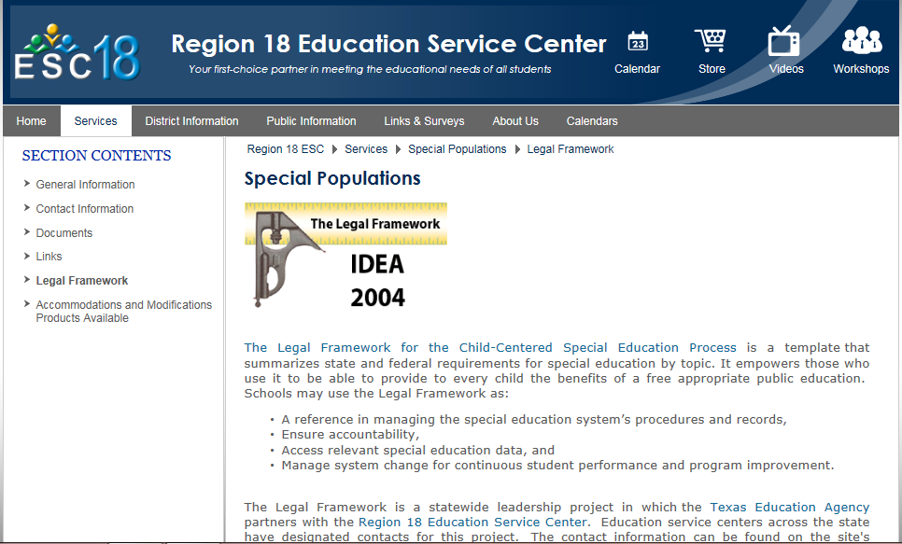
Procedures for Identification
At any time during the assessment for dyslexia, identification process, or instruction related to dyslexia, students may be referred for evaluation for special education services.
Notes:
At times, students will display additional factors complicating their dyslexia or may be unable to make a sufficient rate of academic progress (assuming fidelity to instruction/intervention is maintained) and will require more support than what is available through the general education dyslexia program.
Once a student is referred through IDEA, all procedures are conducted by the ARD committee.
Click on the picture to access the Legal Framework housed on the Region 18 ESC webpages.

Slide 26
Reevaluation for Dyslexia
In 2011, Senate Bill 866 added into law Subsection (b-1) to ensure that districts consider previously collected data before reevaluating students already identified as having dyslexia.
Notes:
This information is found on page 24 of the handbook. Direct the participants to locate Reevaluation for Dyslexia Identification and Accommodations for discussion.
Have participants read and discuss the paragraph on page 24 and use as much time as needed for clarification (approximately five minutes).

Slide 27
Instruction for Students with dyslexia
Chapter iii
Notes:
This is the title slide for Chapter III.

Slide 28
Instruction
TEC §38.003(b) states, In accordance with the program approved by the State Board of Education, the board of trustees of each school district shall provide for the treatment of any student determined to have dyslexia or a related disorder.
Notes:
Direct the participants to page 26 of the handbook, and have them highlight TEC §38.003(b).

Slide 29
Instruction
Each school must provide an identified student access at his/her campus to an instructional program that meets the requirements in 19 TAC §74.28(c) and to services of a teacher trained in dyslexia and related disorders.
Notes:
Direct the participants to page 26 of the handbook, and have them highlight 19 TAC §74.28(c).

Slide 30
Instruction
In accordance with 19 TAC §74.28(c), districts shall purchase or develop a reading program for students with dyslexia and related disorders that incorporates all the components of instruction and instructional approaches in the following sections.
Critical, Evidence-Based Components of Dyslexia Instruction
Delivery of Dyslexia Instruction
Notes:
Direct the participants to page 26 of the handbook, and have them highlight 19 TAC §74.28(c).
Discuss each bullet under Critical, Evidence-Based Components of Dyslexia Instruction on pages 26–27, and use as much time as needed for clarification(approximately ten minutes).
Direct the participants to the last paragraph on page 27, and discuss the importance of collaboration of both the regular education teacher and the dyslexia teacher.
Discuss each bullet under Delivery of Dyslexia Instruction on page 28, and use as much time as needed for clarification (approximately five minutes).

Slide 31
Instruction
In addition, because effective intervention requires highly structured and systematic delivery, it is critical that those who provide intervention for students with dyslexia be trained in the program used and that the program is implemented with fidelity.
Notes:
Direct the participants to locate on page 29 the information from this slide pertaining to teacher training and program fidelity.
Direct the participants to question 41 in Appendix C on page 72 to further discuss fidelity.

Slide 32
Instruction
Instructional Intervention Consideration for English Language Learners (ELLs) with Dyslexia
Address similarities and differences between the first and second languages
Address limited vocabulary in English
Implement the English Language Proficiency Standards (ELPS)
Notes:
This information is found on pages 29–30 of the handbook.
Have the participants read and discuss the paragraphs on pages 29–30, and use as much time as needed for clarification(approximately ten minutes).

Slide 33

Instruction
Research-Based Best Practices
The Texas approach to teaching students with dyslexia is founded on research-based best practices.
Notes:
Have the participants read and discuss the bullets on page 30 that summarize the similarities between research and practice. Use as much time as needed for clarification (approximately ten minutes).

Slide 34
Instruction
Research-Based Best Practices Sources
Teaching students with dyslexia and dysgraphia: Lessons from teaching and science
Multisensory teaching of basic language skills (3rd edition)
Unlocking literacy: Effective decoding and spelling instruction (2nd edition)
Essentials of dyslexia assessment and intervention
Notes:
These four additional sources of research-based practices have been added to this revised edition of the handbook. They are listed on pages 31–32.

Slide 35
Instructional Accommodations
Accommodations are not one size fits all; rather, the impact of dyslexia on each individual student determines the accommodation.
Accommodations are changes to materials, actions, or techniques, including the use of technology, that enable students with disabilities to participate meaningfully in grade-level or course instruction.
Notes:
Direct the participants to page 36 of the handbook, and discuss the list of possible accommodations for students identified with dyslexia.

Slide 36
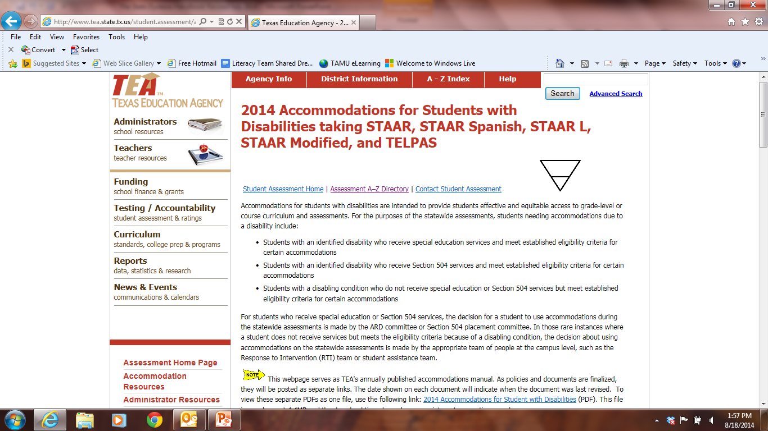
Instructional Accommodations
Notes:
These sources of information are listed beginning on page 37 of the handbook.
Click on the picture in the slide to open the link, and scroll down to show participants the information TEA provides concerning accommodations.

Slide 37
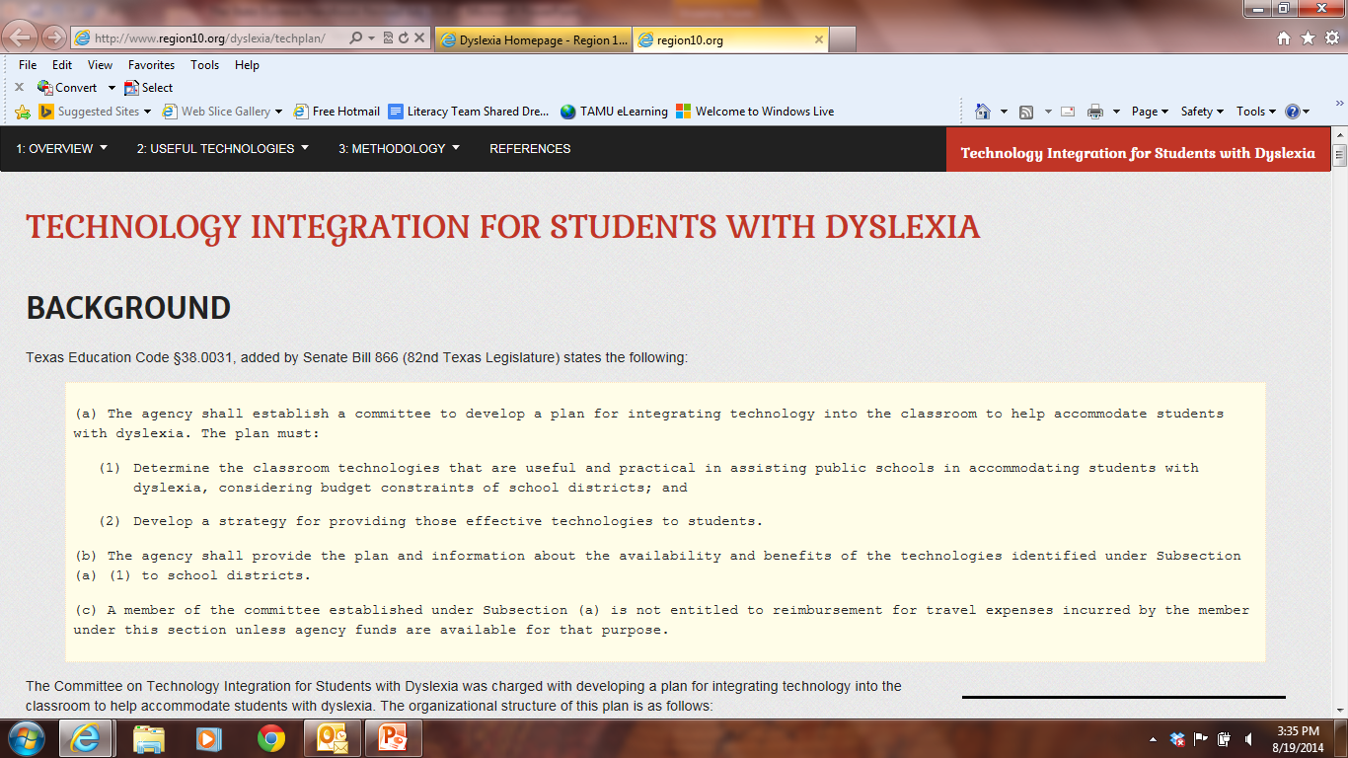
Instructional Accommodations
Notes:
This source of information is listed on page 37 of the handbook.
The Technology Integration for Students with Dyslexia Tool is found on the Region 10 ESC Dyslexia Web page.
Click on the picture in the slide to open the link, and scroll through to show participants the information the tool provides for the use of technology in the classroom, which is often considered an accommodation for the student identified with dyslexia.

Slide 38
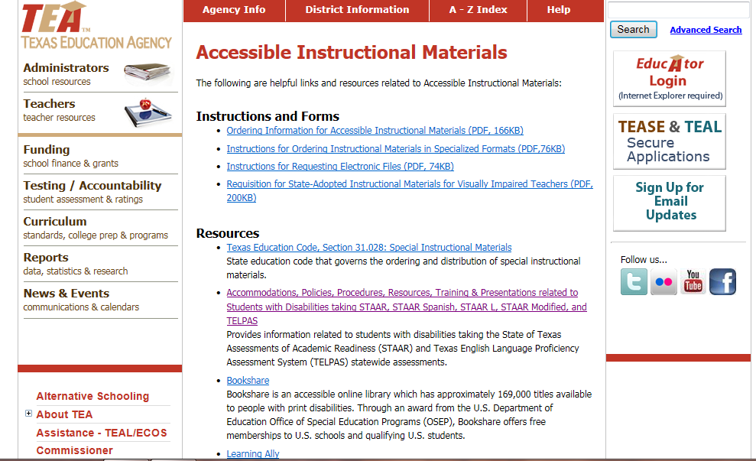
Instructional Accommodations
Notes:
This source of information is listed on page 37 of the handbook.
Accessible Instructional Materials are found on TEA’s website.
Click on the picture in the slide to open the link, and scroll through to show participants the links TEA provides to resources and other accessible instructional materials for students with disabilities, including dyslexia.

Slide 39
Instructional accommodations
Texas State Student Assessment Program Accommodations for Students with Disabilities
  Educators, parents, and students must understand that accommodations provided during classroom instruction and testing might differ from accommodations allowed for use on state assessments.
Notes:
This and associated information is found on pages 37–38 of the handbook.
Have participants read and discuss the bullets on pages 37–38. Use as much time as needed for clarification (approximately five minutes).

Slide 40
Instruction
Enrollment in Gifted/Talented and Advanced Academic Programs
A student who has been identified with dyslexia can also be a gifted learner, or a twice- exceptional learner.
Twice-exceptional students must be provided access to all service and course options available to other students.
Notes:
This and associated information is found on pages 38–39 of the handbook.
Have participants read and discuss the information on page 38. Use as much time as needed for clarification (approximately five minutes).
If time permits, participants may wish to click on the links listed on pages 38–39.

Slide 41
Instruction
Legislative Action to Assist Teachers
  Technology Integration for Students with Dyslexia (TEC §38.0031)
  Professional Development Relative to Dyslexia for All Teachers (TEC §21.054(b) and TAC §232.11(e))
Notes:
This information is found on pages 39–40 of the handbook.
Have participants read and discuss the information on pages 39–40. Use as much time as needed for clarification(approximately five minutes).
If time permits, participants may wish click on the links listed on pages 39–40.

Slide 42
Instruction
Legislative Action to Assist Teachers
  Texas Department of State Health Services (DSHS) Occupations Code Chapter 403: Dyslexia Therapist and Dyslexia Practitioner Licensing Program
Notes:
This information is found on page 40 of the handbook.
Review with the participants this voluntary licensing opportunity.

Slide 43

Instruction
Legislative Action to Assist Teachers
  Educator Preparation Programs (TEC §21.044(c)(2))
Notes:
This information is found on page 40 of the handbook.
Review with the participants this Texas statute concerning university candidates completing an educator preparation program.

Slide 44
Laws & Rules
Appendices A & B
Notes:
This is the title slide for Appendices A & B.

Slide 45
Laws and Rules
This handbook reflects current law including legislative action from the 82nd and 83rd sessions of the Texas Legislature.
Notes:
Appendix A provides a summary of sources of laws and rules for dyslexia identification and instruction. Read and discuss the bullets listed under each subtitle on pages 41–42. Use as much time as needed for clarification(approximately ten minutes).
Appendix B provides the detailed information for each of the state statutes related to dyslexia. Have the participants highlight the following new statutes: TEC §21.044 and TEC §21.054 on page 43; TEC §28.021 on page 46; TEC §38.0031, TEC §42.006(a-1), and TEC §51.9701 on page 47; Texas Occupations Code Chapter 54 on page 48; TAC §228.35 on pages 56–59; TAC §230.23 and TAC §232.11 on page 59.

Slide 46
Questions and Answers
Appendix C
Notes:
This is the title slide for Appendix C.

Slide 47

Questions and Answers
This section provides information about various topics relevant to dyslexia and related disorders in a highly accessible question-and-answer format.
Notes:
This section has 11 topics with many revisions to previous questions and answers. New questions and answers have also been added.
NOTE: It is recommended that you review and discuss the 69 questions and answers in Appendix C. However, there might not be time to discuss all of the questions and answers. You may only have time to discuss the additions made to this section which include questions 5, 7, 11, 14, 17, 20, 24–27, 34–36, 40–42, 47–50, and 64-69.

Slide 48
Contacts for further Information
Appendix D
Notes:
This is the title slide for Appendix D. Direct the participants to pages 80– 81 of the handbook.
Have the participants review pages 82–84 for a list of training centers.

Slide 49
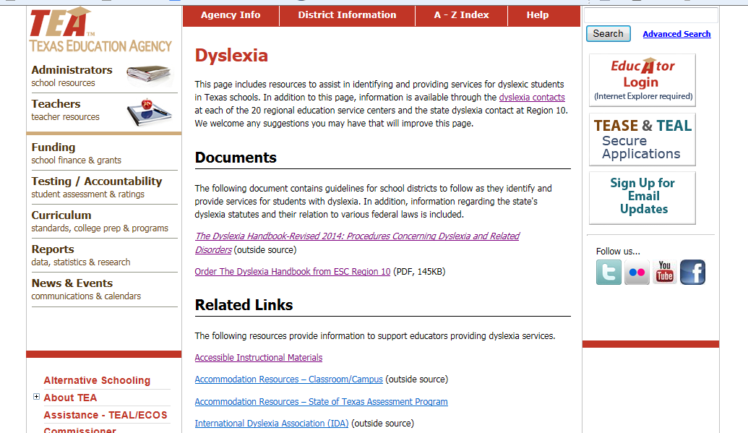
Education Service Centers
Notes:
Click on the picture on the slide, which will link to TEA’s Dyslexia webpage. This slide provides participants with another source of information.

Slide 50
Associated Terms and Bibliography
Appendices E & F
Notes:
This is the title slide for Appendices E and F. Direct the participants to pages 85–96 of the handbook.
Direct the participants to the following terms added to the handbook:
assistive technology
Child Find
cognate
cross-linguistic
developmental auditory imperception
dominant language
dysphasia
evidence-based reading instruction
Free Appropriate Public Education
morphosyllabic writing systems
orthographic awareness
orthographic memory
phonological memory
Semitic writing system
specific developmental dyslexia
syllabic writing system
syntax

Slide 51
Postsecondary education
Appendix G
Notes:
This is the title slide for Appendix G. Direct the participants to pages 97–101 of the handbook.
This additional contact section explains the rights and responsibilities of students with disabilities who are preparing to attend postsecondary schools. Allow the participants to review the questions and answers provided by the Office for Civil Rights. Be sure to point out the additional contact information for additional questions parents and students may have when preparing for college. This information is located on page 100 of the handbook. Use as much time as needed for clarification (approximately five minutes).

Slide 52
Section 504 and
ADA AA 2008
Appendix H
Notes:
This is the title slide for Appendix H. Direct the participants to pages 102–144 of the handbook.
This information was included as a resource.

Slide 53
History of Dyslexia Law
Appendix I
Notes:
This is the title slide for Appendix I. Direct the participants to pages 145–148 of the handbook.
At the request of Mrs. Miller, State Board of Education member, the following History of Dyslexia Law is included in memory of Dr. Luke Waites, founding Medical Director of the Center for Dyslexia and Learning Disorders at the Texas Scottish Rite Hospital for Children.

Slide 54
Region 4 Dyslexia Contact
Windy Clark, Ed.D. Dyslexia Specialist windy.clark@esc4.net
Notes:
Change this slide to reflect the contact information of your ESC.

Slide 55

It is the policy of Region 10 Education Service Center not to discriminate on the basis of race, color, national origin, gender or handicap in its vocational programs, services or activities as required by Title VI of the Civil Rights Act of 1964, as amended; Title IX of the Education Amendments of 1972; and Section 503 and 504 of the Rehabilitation Act of 1973, as amended. Region 10 Education Service Center will take steps to ensure that lack of English language skills will not be a barrier to admission and participation in all educational programs and services.

Slide 56

Copyright © Texas Education Agency, 2014. These Materials are copyrighted © and trademarked ™ as the property of the Texas Education Agency (TEA) and may not be reproduced without the express written permission of TEA, except under the following conditions:
1) Texas public school districts, charter schools, and Education Service Centers may reproduce and use copies of the Materials and Related Materials for the districts’ and schools’ educational use without obtaining permission from TEA.
2) Residents of the state of Texas may reproduce and use copies of the Materials and Related Materials for individual personal use only, without obtaining written permission of TEA.
3) Any portion reproduced must be reproduced in its entirety and remain unedited, unaltered and unchanged in any way.
4) No monetary charge can be made for the reproduced materials or any document containing them; however, a reasonable charge to cover only the cost of reproduction and distribution may be charged.
Private entities or persons located in Texas that are not Texas public school districts, Texas Education Service Centers, or Texas charter schools or any entity, whether public or private, educational or non-educational, located outside the state of Texas MUST obtain written approval from TEA and will be required to enter into a license agreement that may involve the payment of a licensing fee or a royalty.
For information contact: Office of Copyrights, Trademarks, License Agreements, and Royalties, Texas Education Agency, 1701 N. Congress Ave., Austin, TX 78701-1494; phone 512-463-9041; email copyrights@tea.state.tx.us.

